Slide 1
CIFAR-10 분류 구현

Slide 2
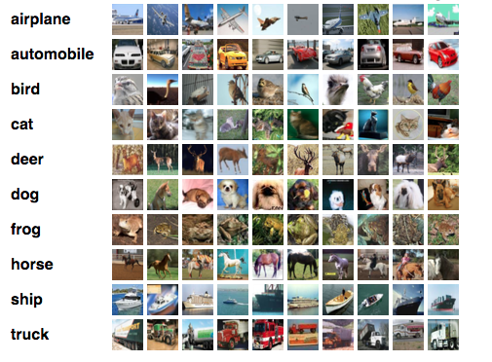
CIFAR-10 데이터셋
Canadian Institute For Advanced Research
비행기, 자동차 등 사물의 10 개 분류
손글씨와 구조가 비슷하며 칼라
50000개(학습용), 10000개(테스트용), 32 X 32 X 3 이미지 구조, 10개의 분류
비행기, 자동차, 새, 고양이, 사슴, 개, 개구리, 말, 배(ship), 트럭

Slide 3
파일
7-1 cifar10_basic_dnn.ipynb

Slide 4

CIFAR-10 데이터 저장
datasets.cifar10.load_data()
import numpy as np
import matplotlib.pyplot as plt
import tensorflow as tf
from tensorflow import keras
from tensorflow.keras import datasets, layers, models
cifar10 = datasets.cifar10
(train_images, train_labels), (test_images, test_labels) = cifar10.load_data()
class_names = ['airplane', 'automobile', 'bird', 'cat', 'deer', 'dog', 'frog', 'horse', 'ship', 'truck']
print("Train samples:", train_images.shape, train_labels.shape)
print("Test samples:", test_images.shape, test_labels.shape)

Slide 5
이미지와 레이블
(50000, 32, 32, 3)
array([[[ 59, 62, 63], [ 43, 46, 45], [ 50, 48, 43], ..., [158, 132, 108], [152, 125, 102], [148, 124, 103]], [[ 16, 20, 20], [ 0, 0, 0], [ 18, 8, 0], ..., [123, 88, 55], [119, 83, 50], [122, 87, 57]], [[ 25, 24, 21], [ 16, 7, 0], [ 49, 27, 8], ..., [118, 84, 50], [120, 84, 50], [109, 73, 42]], ..., [[208, 170, 96], [201, 153, 34], [198, 161, 26], ..., [160, 133, 70], [ 56, 31, 7], [ 53, 34, 20]], [[180, 139, 96], [173, 123, 42], [186, 144, 30], ..., [184, 148, 94], [ 97, 62, 34], [ 83, 53, 34]], [[177, 144, 116], [168, 129, 94], [179, 142, 87], ..., [216, 184, 140], [151, 118, 84], [123, 92, 72]]], dtype=uint8)
이미지
레이블
print(train_images.shape)
train_images[0]
print(train_labels.shape)
Train_labels
(50000, 1)
array([[6], [9], [9], ..., [9], [1], [1]], dtype=uint8)

Slide 6
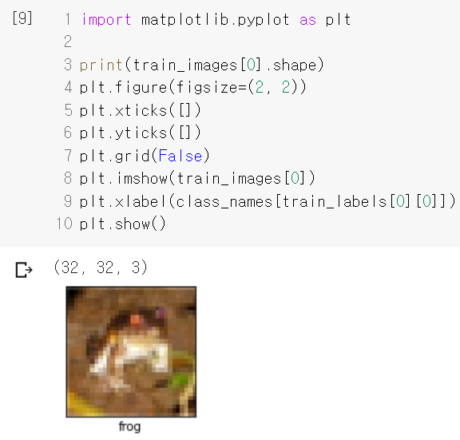
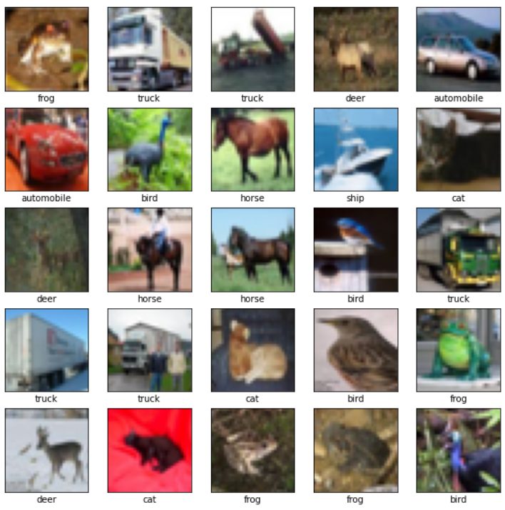
이미지 보기
하나 보기
25개 보기
plt.figure(figsize=(10, 10))
for i in range(25):
plt.subplot(5, 5, i+1)
plt.xticks([])
plt.yticks([])
plt.grid(False)
plt.imshow(train_images[i])
plt.xlabel(class_names[train_labels[i][0]])
plt.show()
train_images = train_images/255.0
test_images = test_images/255.0

Slide 7
모델 Sequential
model = models.Sequential()
model.add(layers.Flatten())
model.add(layers.Dense(256, activation='relu'))
model.add(layers.Dense(128, activation='relu'))
model.add(layers.Dense(64, activation='relu'))
model.add(layers.Dense(10, activation='softmax'))
model.compile(optimizer='adam', loss='sparse_categorical_crossentropy', metrics=['accuracy'])
model.fit(train_images, train_labels, epochs=10)
test_loss, test_acc = model.evaluate(test_images, test_labels)
print('Test accuracy:', test_acc)
Epoch 8/10
1563/1563 [==============================] - 12s 7ms/step - loss: 1.4363 - accuracy: 0.4877
Epoch 9/10
1563/1563 [==============================] - 12s 7ms/step - loss: 1.4196 - accuracy: 0.4935
Epoch 10/10
1563/1563 [==============================] - 12s 8ms/step - loss: 1.3981 - accuracy: 0.5001
313/313 [==============================] - 1s 3ms/step - loss: 1.5084 - accuracy: 0.4705
Test accuracy: 0.47049999237060547

Slide 8
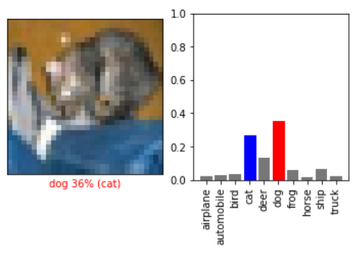
이미지와 예측 확률 그리기
def plot_image(i, predictions_array, true_label, img):
predictions_array, true_label, img = predictions_array[i], true_label[i], img[i]
plt.grid(False)
plt.xticks([])
plt.yticks([])
plt.imshow(img, cmap=plt.cm.binary)
predicted_label = np.argmax(predictions_array)
if predicted_label == true_label:
color = 'blue'
else:
color = 'red'
plt.xlabel("{} {:2.0f}% ({})".format(class_names[predicted_label],
100*np.max(predictions_array),
class_names[true_label[0]]),
color=color)
def plot_value_array(i, predictions_array, true_label):
predictions_array, true_label = predictions_array[i], true_label[i]
plt.grid(False)
thisplot = plt.bar(range(10), predictions_array, color="#777777")
plt.ylim([0, 1])
predicted_label = np.argmax(predictions_array)
thisplot[predicted_label].set_color('red')
thisplot[true_label[0]].set_color('blue')
# 각 종류 레이블을 직접 세로로 출력
xlabel = [class_names[i] for i in range(10)]
plt.xticks(np.arange(10), xlabel, rotation='vertical')

Slide 9
첫 데스트 이미지와 확률값 그리기
predictions = model.predict(test_images)
i = 0
plt.figure(figsize=(6,3))
plt.subplot(1,2,1)
plot_image(i, predictions, test_labels, test_images)
plt.subplot(1,2,2)
plot_value_array(i, predictions, test_labels)
plt.show()

Slide 10
CIFAR-10 분류 CNN 구현

Slide 11
이미지 로드와 보기
cifar10.load_data()
채널이 마지막에 위치한 구조(last channel)라 reshape이 필요 없음
import numpy as np
import matplotlib.pyplot as plt
import tensorflow as tf
from tensorflow import keras
from tensorflow.keras import datasets, layers, models
cifar10 = datasets.cifar10
(train_images, train_labels), (test_images, test_labels) = cifar10.load_data()
class_names = ['airplane', 'automobile', 'bird', 'cat', 'deer', 'dog', 'frog', 'horse', 'ship', 'truck']
print("Train samples:", train_images.shape, train_labels.shape)
print("Test samples:", test_images.shape, test_labels.shape)
#train_images = train_images.reshape((50000, 32, 32, 3))
#test_images = test_images.reshape((10000, 32, 32, 3))
Train samples: (50000, 32, 32, 3) (50000, 1) Test samples: (10000, 32, 32, 3) (10000, 1)

Slide 12
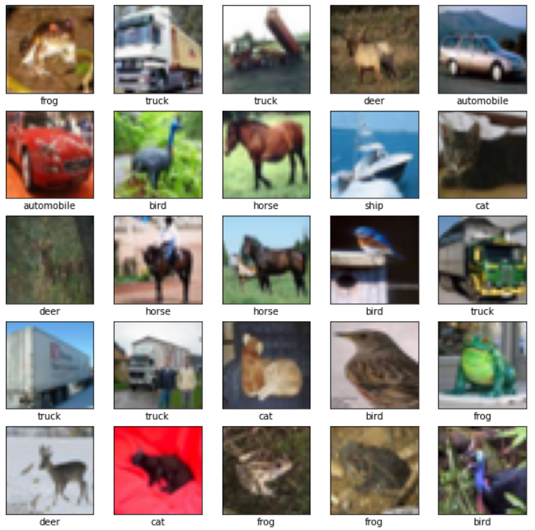
이미지 보기
5 x 5 이미지 그리기
plt.figure(figsize=(10, 10))
for i in range(25):
plt.subplot(5, 5, i+1)
plt.xticks([])
plt.yticks([])
plt.grid(False)
plt.imshow(train_images[i])
plt.xlabel(class_names[train_labels[i][0]])
plt.show()

Slide 13
CNN 모델 생성, 학습, 평가
컨볼루션 신경망(convolutional neural network) 기반 이미지 분류기
train_images = train_images/255.0
test_images = test_images/255.0
model = models.Sequential()
model.add(layers.Conv2D(32, (3, 3), activation='relu', input_shape=(32, 32, 3)))
model.add(layers.MaxPooling2D((2, 2)))
model.add(layers.Conv2D(64, (3, 3), activation='relu'))
model.add(layers.MaxPooling2D((2, 2)))
model.add(layers.Conv2D(64, (3, 3), activation='relu'))
model.add(layers.Flatten())
model.add(layers.Dense(64, activation='relu'))
model.add(layers.Dense(10, activation='softmax'))
model.compile(optimizer='adam', loss='sparse_categorical_crossentropy', metrics=['accuracy'])
model.fit(train_images, train_labels, epochs=10)
test_loss, test_acc = model.evaluate(test_images, test_labels)
print('Test accuracy:', test_acc)
filters, kernel_size, …
Epoch 10/10
1563/1563 [==============================] - 9s 6ms/step - loss: 0.5993 - accuracy: 0.7891
313/313 [==============================] - 1s 3ms/step - loss: 0.8726 - accuracy: 0.7083
Test accuracy: 0.708299994468689

Slide 14
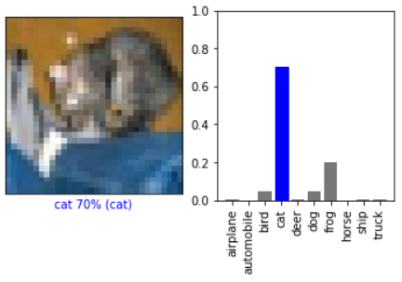
이미지 그리기 함수
def plot_image(i, predictions_array, true_label, img):
predictions_array, true_label, img = predictions_array[i], true_label[i], img[i]
plt.grid(False)
plt.xticks([])
plt.yticks([])
plt.imshow(img, cmap=plt.cm.binary)
predicted_label = np.argmax(predictions_array)
if predicted_label == true_label:
color = 'blue'
else:
color = 'red'
plt.xlabel("{} {:2.0f}% ({})".format(class_names[predicted_label],
100*np.max(predictions_array),
class_names[true_label[0]]),
color=color)

Slide 15
확률 값 그리기
def plot_value_array(i, predictions_array, true_label):
predictions_array, true_label = predictions_array[i], true_label[i]
plt.grid(False)
#plt.xticks([])
#plt.yticks([])
thisplot = plt.bar(range(10), predictions_array, color="#777777")
plt.ylim([0, 1])
predicted_label = np.argmax(predictions_array)
thisplot[predicted_label].set_color('red')
thisplot[true_label[0]].set_color('blue')
# 각 종류 레이블을 직접 세로로 출력
xlabel = [class_names[i] for i in range(10)]
plt.xticks(np.arange(10), xlabel, rotation='vertical')

Slide 16
첫 테스트 이미지와 확률값 그리기
predictions = model.predict(test_images)
i = 0
plt.figure(figsize=(6,3))
plt.subplot(1,2,1)
plot_image(i, predictions, test_labels, test_images)
plt.subplot(1,2,2)
plot_value_array(i, predictions, test_labels)
plt.show()

Slide 17
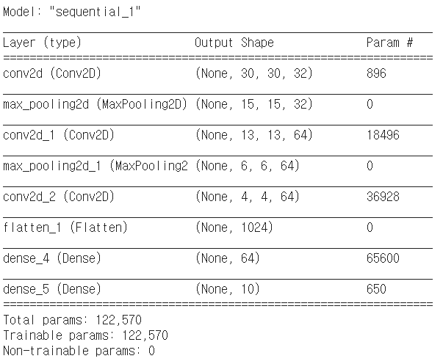
가중치와 편향 수
model = models.Sequential()
model.add(layers.Conv2D(32, (3, 3), activation='relu', input_shape=(32, 32, 3)))
model.add(layers.MaxPooling2D((2, 2)))
model.add(layers.Conv2D(64, (3, 3), activation='relu'))
model.add(layers.MaxPooling2D((2, 2)))
model.add(layers.Conv2D(64, (3, 3), activation='relu'))
model.add(layers.Flatten())
model.add(layers.Dense(64, activation='relu'))
model.add(layers.Dense(10, activation='softmax'))
model.summary()
(None, 32, 32, 3)
커널 수(K) * 커널 사이즈(F)² * (채널:색상 수(D)) + 커널 수(K)
32 * 3*3 * 3 + 32 = 896
커널 수(K) * 커널 사이즈(F)² * (채널:색상 수(D)) + 커널 수(K)
64 * 3*3 * 32 + 64 = 18,496
커널 수(K) * 커널 사이즈(F)² * (채널:색상 수(D)) + 커널 수(K)
64 * 3*3 * 64 + 64 = 36,928
(이전 출력 노드 수 + 1) * 노드 수
(1024 + 1) * 64
(64 + 1) * 10

